Slide 1
Interactive Digital Portfolio
CAPSTONE PROJECT
Presented By:
Student Name : PADALA SAI BAPI REDDY
College Name & Department : BHARATH INSTITUTE OF HIGHER EDUCATION AND RESERCH & CSE[AIML]

Slide 2
OUTLINE
Problem Statement
Technology used
Wow factor
End users
Result
Conclusion
Git-hub Link
Future scope

Slide 3
Problem Statement
Many developers struggle to present their skills and projects in a way that is both engaging and professional. Traditional resumes are static, lack interactivity, and fail to highlight creativity or technical depth. Recruiters often find it difficult to assess real capabilities through plain text documents. Portfolios in PDF or Word formats also lack visual appeal and dynamic elements. This creates a communication gap between a developer’s abilities and how they are perceived. Hence, there is a need for an interactive and visually appealing digital portfolio to effectively showcase talent.

Slide 4
Technology used
HTML5 – structure and content.
CSS3 – styling, layout, responsiveness.
JavaScript (ES6) – interactivity and logic.
GSAP (Green Sock Animation Platform) – advanced animations.
Scroll Magic – scroll-based interactive effects.
Bootstrap / Tailwind CSS – responsive UI framework.
GitHub – version control and repository hosting.
Netlify / GitHub Pages – deployment platforms.

Slide 5
Wow factors
What makes this project stand out from traditional portfolios is its high level of interactivity and modern design elements. Smooth transitions are achieved using GSAP animations, while ScrollMagic introduces scroll-triggered effects that create an engaging browsing experience. The portfolio is fully responsive, ensuring it adapts seamlessly across desktop, tablet, and mobile devices. Unlike static resumes, it includes live project previews with GitHub/demo links, allowing recruiters to experience real work instantly. Added micro-interactions such as hover effects, animated buttons, and smooth navigation give it a polished, professional look. Overall, the portfolio serves not only as a skills showcase but also as a personal brand identity, making it memorable and unique compared to conventional resumes.

Slide 6
End users
Job-seeking developers who want to showcase their skills and projects.
Freelancers aiming to present their portfolio to potential clients.
Students applying for internships or entry-level positions.
Recruiters and hiring managers looking for engaging, easy-to-navigate candidate profiles.
Peers and collaborators who want to explore a developer’s work for team projects.
Personal brand builders who wish to establish an online professional identity.
Tech communities/online forums where developers share portfolios for networking.
Startups/companies searching for creative portfolios to evaluate talent quickly

Slide 7
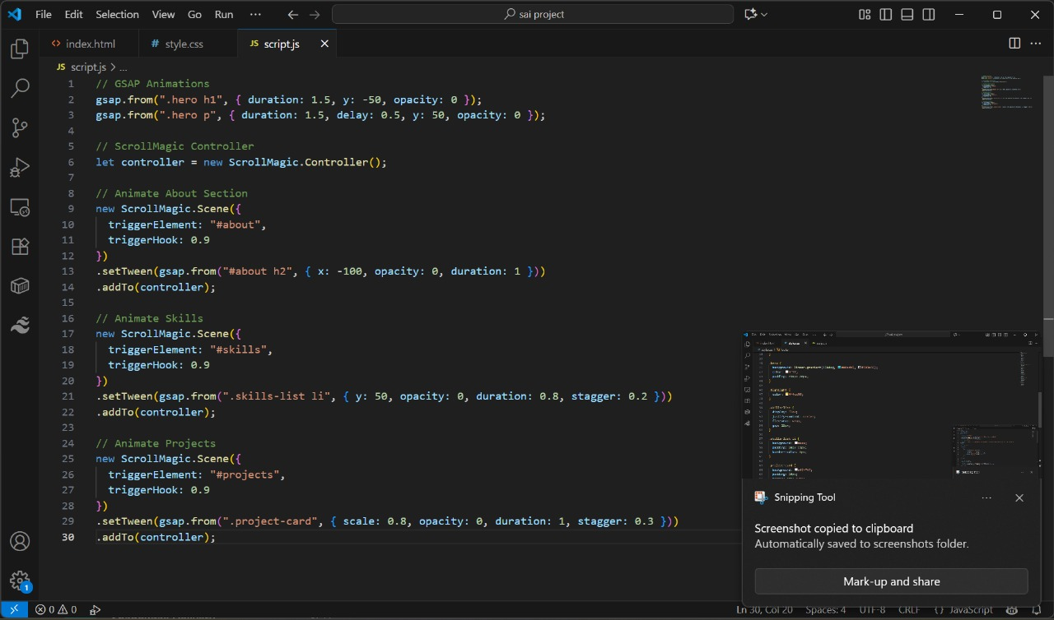
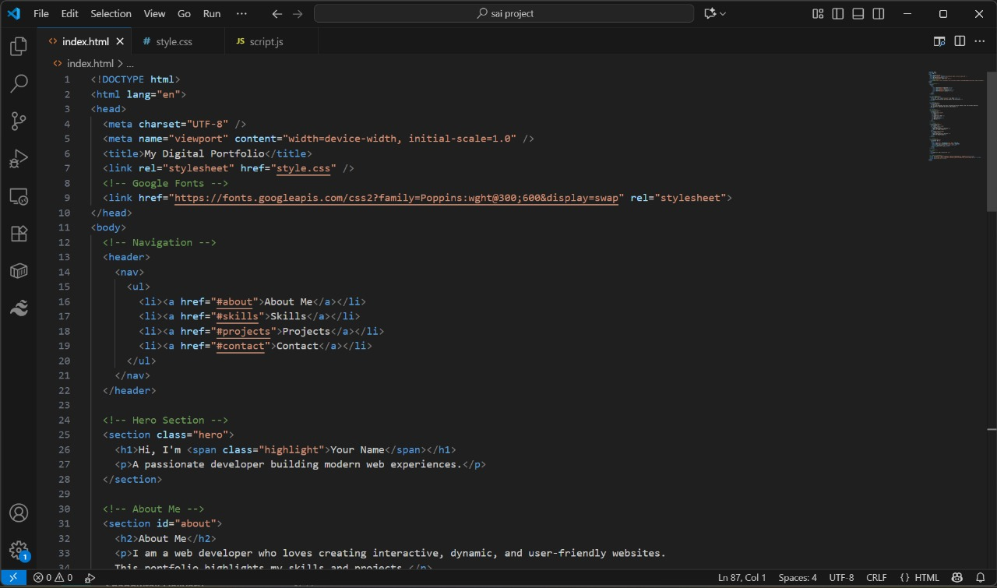
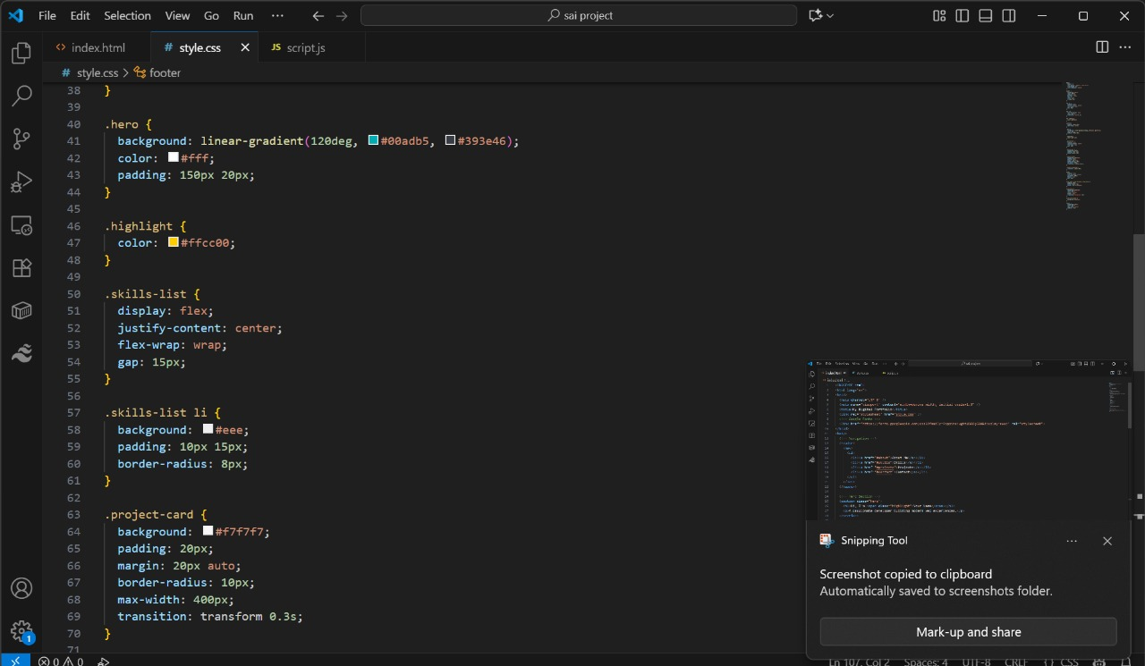
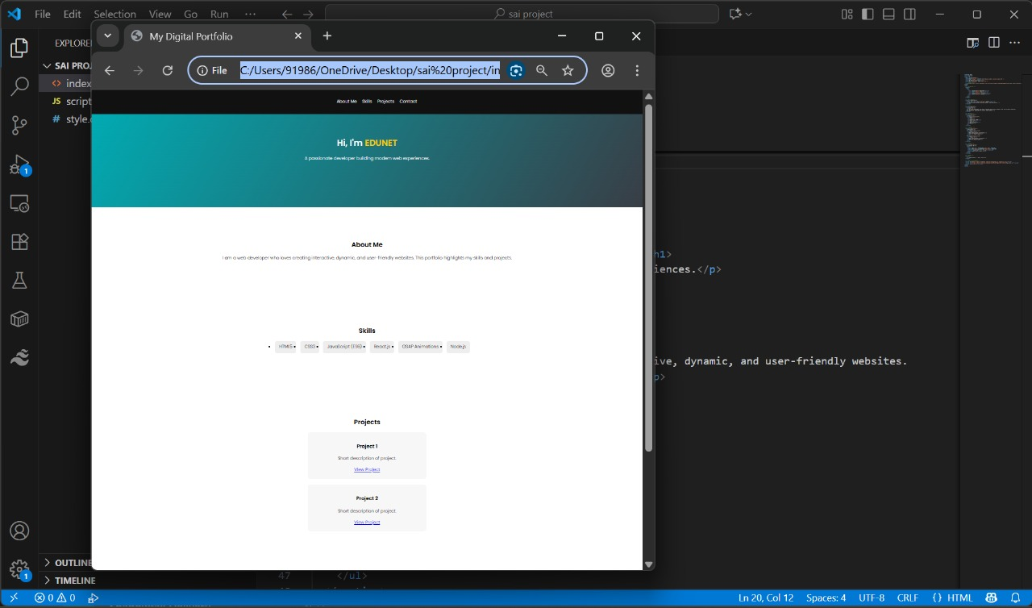
Results

Slide 8
Conclusion
This project successfully addresses the limitations of traditional resumes and static portfolios by offering a dynamic and interactive solution. Developers can now showcase their skills, projects, and creativity in a visually appealing format that captures attention. The use of modern technologies and animation libraries ensures smooth navigation and engaging user experiences. By making portfolios responsive and accessible across devices, the project bridges the gap between a developer’s true abilities and how they are perceived by recruiters or clients. It not only enhances professional visibility but also strengthens personal branding. In conclusion, the interactive digital portfolio effectively solves the problem of dull, static resumes by transforming them into engaging, memorable experiences.

Slide 9
GitHub Link
https://github.com/saibapireddypadala/INTERACTIVE-DIGITAL-PORTFOLIO.git

Slide 10
Future scope(optional)
Integration of blogs or articles to share knowledge and insights.
Addition of AI-based recommendations to highlight top skills or projects.
Incorporating chatbots for real-time communication with recruiters/clients.
Support for multimedia content such as videos, 3D models, or VR experiences.
Option for multi-user templates, allowing others to create their own portfolios.
Linking with LinkedIn, GitHub, or APIs for automatic updates.
Adding analytics dashboards to track visitors and engagement.
Integration of dark/light themes for personalization.

Slide 11
THANK YOU

